Slide 1
Where2Go
Jim Tatarakis
Alex Engelmann
Liam Hartigan

Slide 2

Grand Problem
People looking for
Events near them
Weather near them

Slide 3

Target Audience
Anyone living in or visiting the United States

Slide 4
Vision
To display local events and weather during the current week anywhere in the United States

Slide 5
Minimum Viable Product (MVP)
A website that allows users in the United States to access local weather and event data using only a postal code

Slide 6

User Stories
If I use the app, I want to be able to change the location of my search if I’m out of town
I want a simple streamlined format because I’m busy.
I want a visual representation of the weather because it will help me be more efficient in my search!

Slide 7
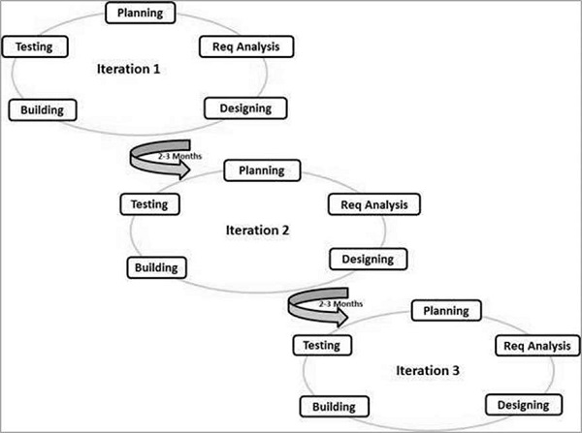
Agile Software Development
Development is iterative, with new functionality being continuously added and tested
A lot of trial and error as we implemented new features and merged them into the project in GitHub

Slide 8







Implemented Technologies
SASS
Yelp Fusion API
OpenWeatherMap API
Materialize
Firebase
Moment
jQuery

Slide 9
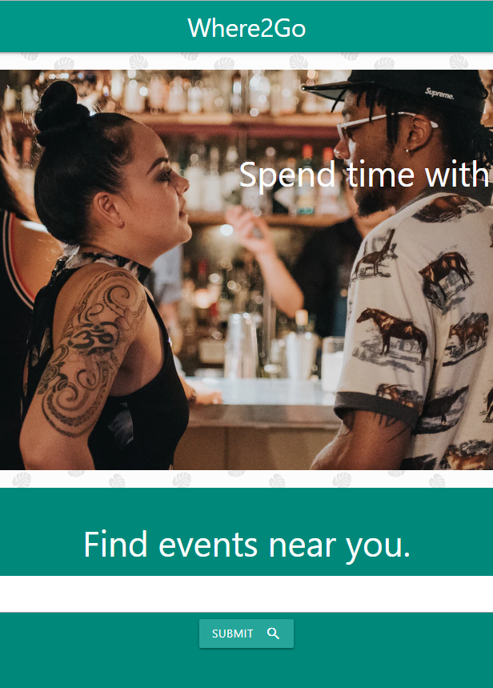
Demonstration

Slide 10
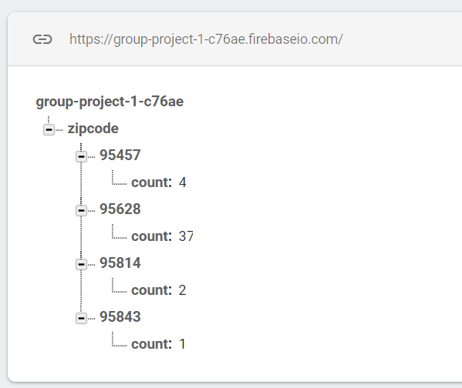
Marketing Data
Using FireBase user zip codes are logged
This information is collected and could be used in the future as a metric of:
Active users
Their location

Slide 11

Limitations
Yelp mostly provides event information for large American cities
Other APIs may be better
Only US postal codes accepted
Limitations of weather forecasting
Limited error handling

Slide 12
Conclusion
We created a functional product that satisfies our MVP goal

Slide 13

The Path Ahead
Error handling
Testing for valid zip codes
Multiple events per day
Data structures in place
More detailed weather information
Improved weather icons
Allow other forms of location like city names
Supported by Yelp and OpenWeatherMap

Slide 14

Questions

